Slide 1
Asynchronous Collaborative Editing
Bogdan Dumitriu
Andrei Vancea
ETH Zürich, 19 May 2004

Slide 2
Outline
Relate to previous presentation
Graphical editors
  editor features
  operation based editor
    types of conflicts
    update stage of the algorithm
    compression algorithm
    example
  state based editor
Further developments

Slide 3
Covered in first presentation
Editing modes – synchronous and asynchronous
Benefits of asynchronous mode
Participants: clients, repository
Operations:
  commit
  update
  checkout

Slide 4
Asynchronous communication
Repository
not committed
(1) checkout
(7) update
(2) checkout
(6) commit
(9) commit
SITE 1
(4) commit
SITE 2
(3) modify
(5) modify
(8) merge

Slide 5
Merging
state based
  information about the states of documents
  no information about the evolution between states
operation based
  uses information about the evolution of one state into another

Slide 6
Text editor
our first project: text editor
  operation based
  asynchronous
  tree representation of document
  tree based operation merging
  multiple granularities
  direct user synchronization
successfully used it in writing some chapters of our papers

Slide 7
Graphical editor
First solution:
  operation based graphical editing
  variant of algorithm from real time
  more efficient for large documents
Second solution:
  state based graphical editing
  own algorithm
  suitable for smaller documents

Slide 8
Editor features
Types of graphical objects
  line
  rectangle
  ellipse
  text
Multi-level group/ungroup support
  tree representation of document
  joint management of objects in a group
  separate management of objects in a group

Slide 9
Properties of graphical objects
foreground color
background color (rectangle, ellipse, text)
position on z-axis
top left & bottom right point (rectangle, ellipse, text); start & end point (line)
content (for text objects only)

Slide 10
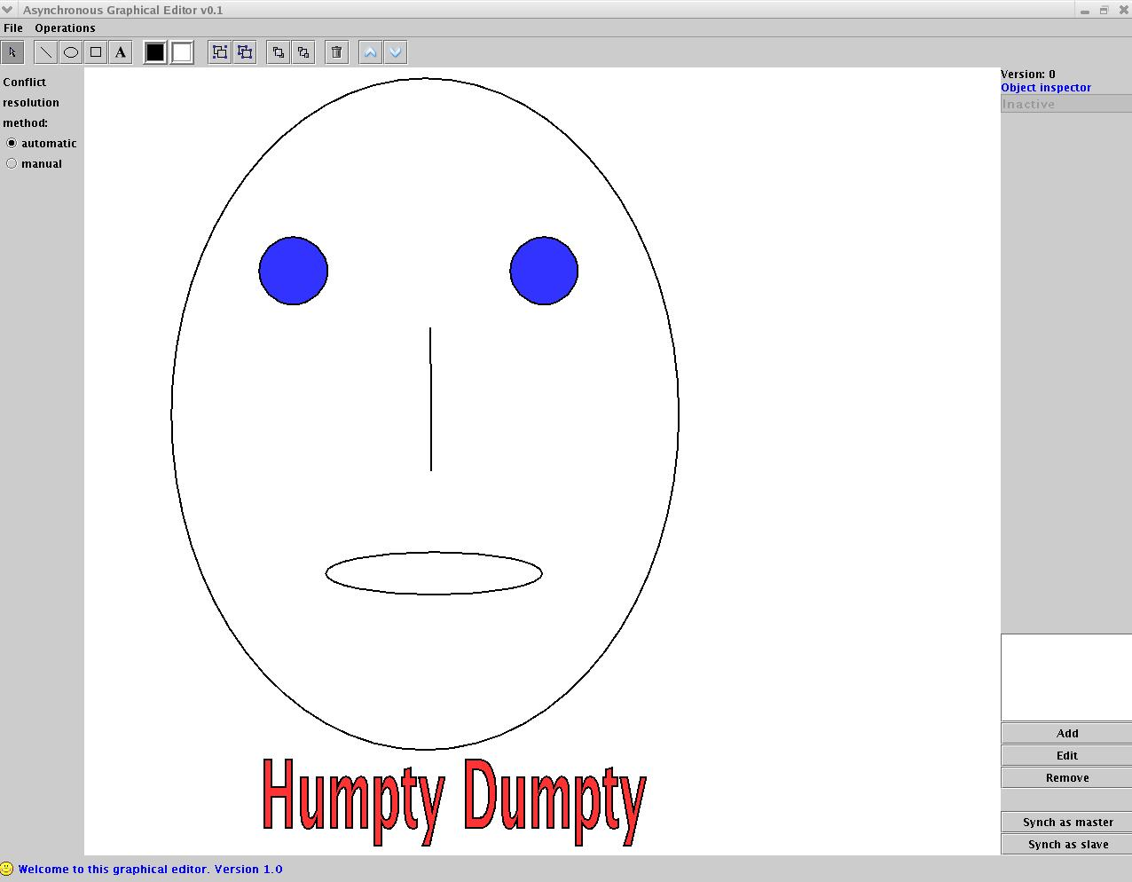
Tree Representation
Root
“Humpty Dumpty”
Face Group
Eyes Group
Nose line
Mouth ellipse
Head ellipse
left eye
right eye

Slide 11
Operations
create / delete object
set foreground color
set background color
set text
bring to front / send to back
scale
translate
group / ungroup

Slide 12
The two editors
Operation based
  single log per document
  when an operation is generated
    the tree structure is updated
    the operation is added to the log
State based
  no log needed
  operations only update the tree structure

Slide 13
Operation based editor
Asynch. variant of last year project
First attempt: apply the generic merging algorithm we used for text editing
Several problems specific to graphical editing appeared
The alternative: adapt the algorithm used for synchronous graphical editor

Slide 14
Operation based editor
Types of Conflicts
Real Conflicts – the two operations can not be both kept
  Ex: both operations change the color of the same object
Resolvable conflicts – both operations can be kept but their order might have to be changed
  Ex: op1 changes the color of a group and op2 changes the color of an object in that group

Slide 15
Operation based editor
Types of Conflicts (2)
Resolvable conflicts
  right order – op1 in right order with op2 if by executing op1 before op2 both their intentions are preserved
  reverse order - op1 in reverse order with op2 if op2 has to be executed before op1 to preserve both their intentions

Slide 16
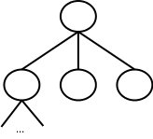
Operation based editor
Update stage
Local Log
Merge
Combined
Log
Remote Log
+
Compress
Inverse
Inversed
Remote Log
New
Local Log
Last synch
document

Slide 17
Operation based editor
Update stage (2)
Apply
Combined
Log
Remote Log
on
Last synch
document
New last synch
document
New
Document

Slide 18
Operation based editor
Merge
Remote
Op
=
Local Ops
No conflict
Right order
resolvable
conflicts
Reverse order
resolvable
conflicts
Real
conflict

Slide 19
Operation based editor
Merge – possible outcomes
No real conflicts
2. Real conflict –
Remote winner
3. Real conflict –
Local winner
No conflict
Right order
Reverse
order
Real conflict
Remote op
Original op

Slide 20
Operation based editor
Compress
Situations when compression is done:
  removal of operations that have no effect (e.g. object is already red and a SetBgColor(red) is done)
  removal of two inverse operations (e.g. Translate(dx,dy) & Translate(-dx,-dy))
  removal of masked operations
  combining two operations into one (e.g. Translate(dx1,dy1) & Translate(dx2,dy2) =>Translate(dx1+dx2,dy1+dy2)

Slide 21
Operation based editor
Example
Repository
G1
G1
G1
Hello
Hello
Hello
SetColor(G1, blue)
Ungroup(G1)
Translate(“Hello”, -10, -10)
SetColor(circle, green)
Group(G2, [G1, line])
Translate(“Hello”, 10, 5)
G1
Hello
Update
Hello
Hello
commit

Slide 22
State based editor
Attribute Merging
compare only the leaves of the two trees
uses “Last synch document” as reference
for a pair of corresponding leaves
  if one is changed and one isn’t => the change is preserved
  if both are changed => one of them is chosen

Slide 23
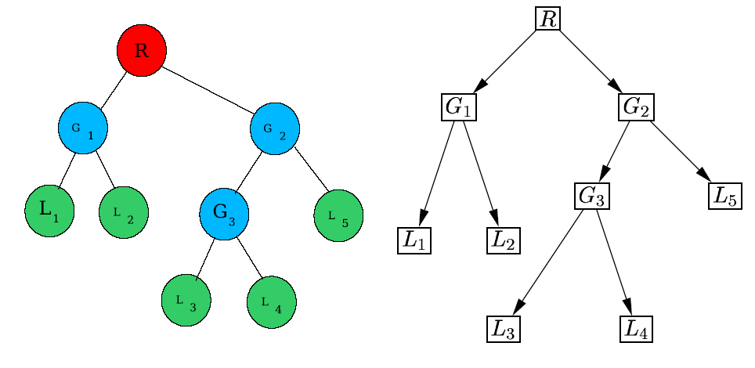
State based editor
Structure merging

Slide 24
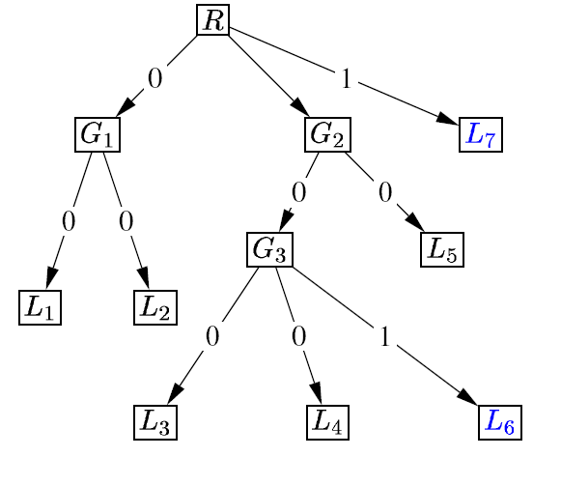
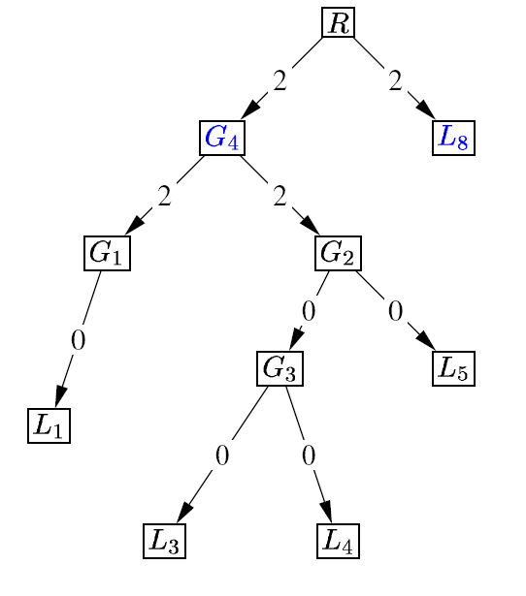
State based editor
Structure merging (2)
Local Graph
Remote Graph

Slide 25
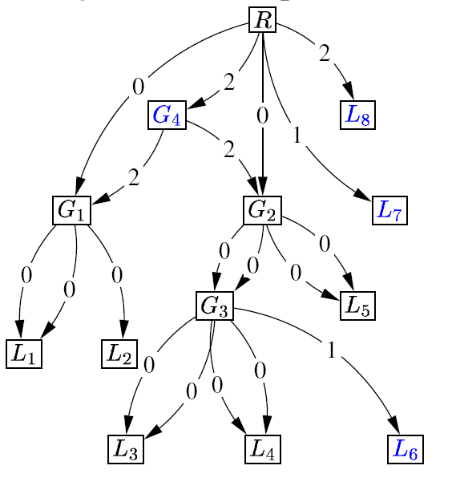
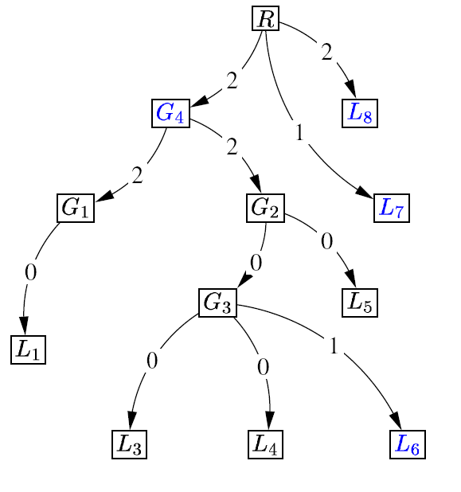
State based editor
Structure merging (3)
Merged Graph
Final Graph

Slide 26
In the end…
To the best of our knowledge, this is the only existing asynchronous graphical editor
A new idea: apply a more generic algorithm based on topological sorting of a graph
Allow users to collaboratively manipulate graphical objects in a text document

